Slide 1
Using Medical Literature to Improve Neural Network Diagnoses
Dylan Siegler

Slide 2
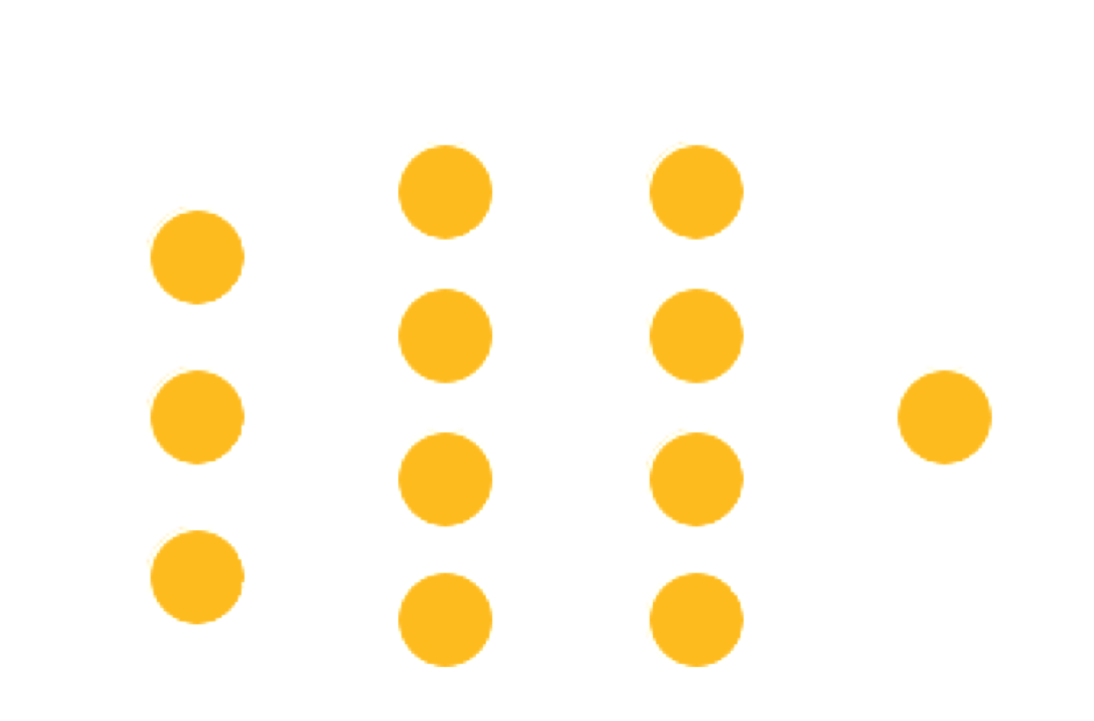
What is a Neural Network?

Slide 3
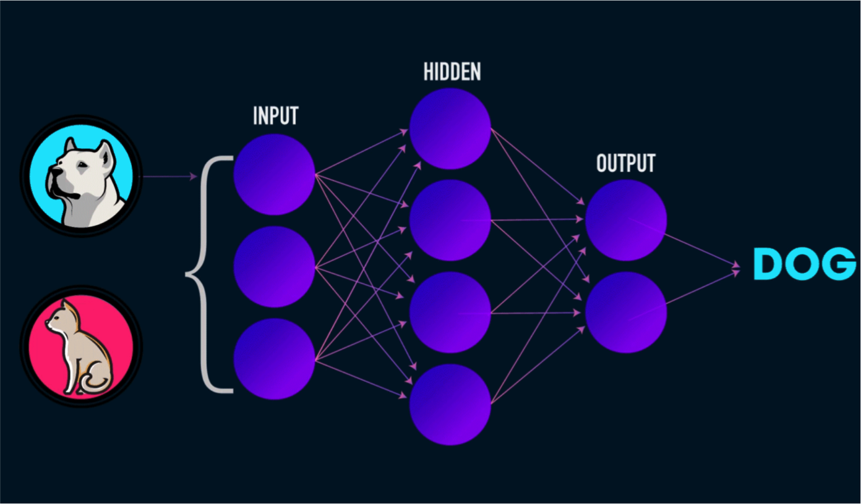
Example Network
Notes:
The network is a “black box,” by training it learns the correct weights for each node in order to maximize its prediction accuracy (or otherwise reach the target)

Slide 4
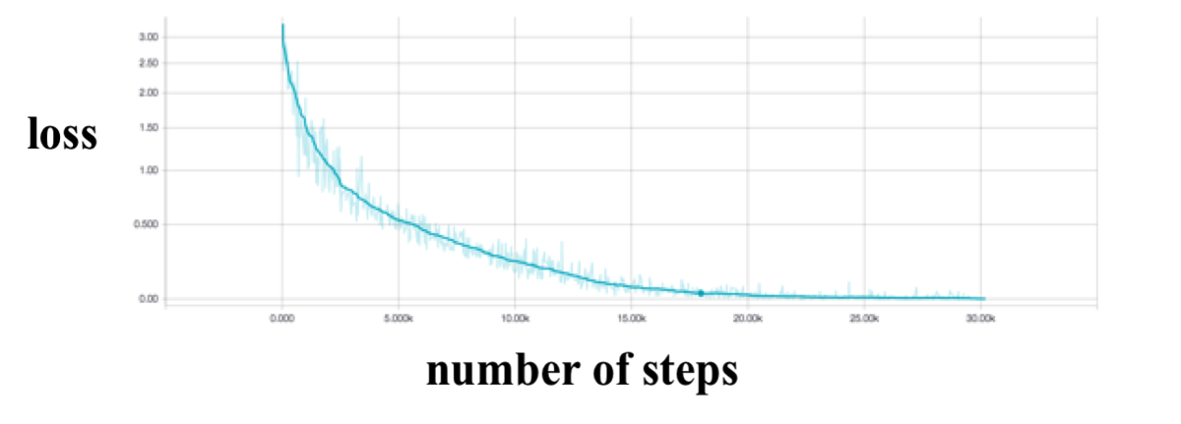
How is a Neural Network “Trained”
Feed the network an example with a known answer
Have it attempt to give the correct answer on it’s own
Compare the real answer with the predicted answer and adjust the network slightly so that it would come closer to the right answer next time
Repeat many times with many examples
Notes:
Backprop – most common way to train

Slide 5
Project Goals
Developing a largely unexplored neural network architecture for integrating two dissimilar data types into a neural network
Testing if such an architecture could be useful in this specific application

Slide 6
What Neural Networks am I Using?
First, an autoencoder network to convert text to numbers
Second, a classification network that takes in patient data and, with the help of the medical literature, outputs a diagnosis prediction

Slide 7
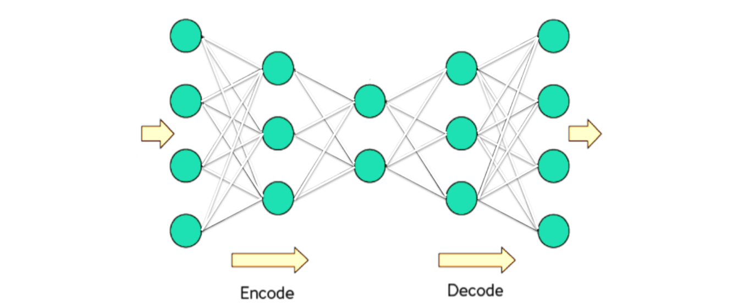
The Autoencoder
Medical literature fed in
Decoded text
Compressed text in numerical form found here
Discarded after training

Slide 8
Why Is Such a Complex Algorithm Used to Convert Text to Numbers
The autoencoder offers the massive benefit of encoding words based on semantic similarity
This property isn’t explicitly coding in, but rather arises from training
Semantically similar words are encoded close in space

Slide 9
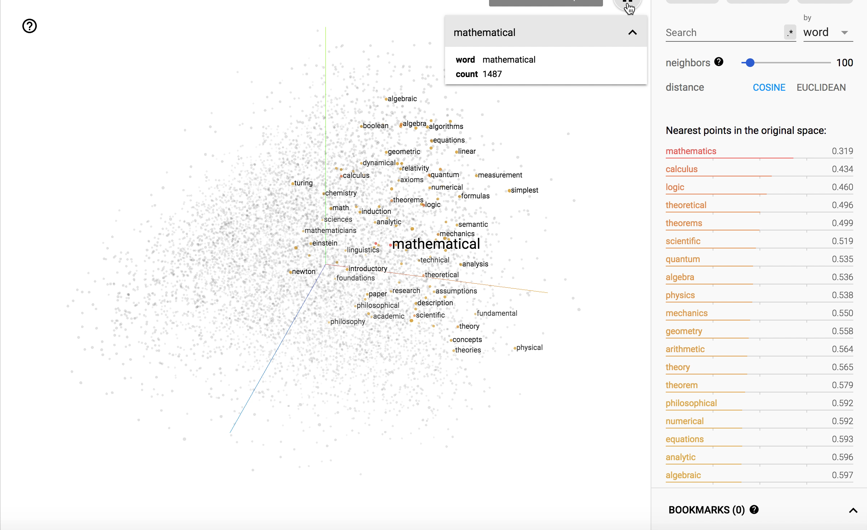
Result of the Autoencoder
Semantically close words are close in space

Slide 10

The Classification Network
Medical literature data from autoencoder
Diagnosis prediction
Patient data

Slide 11
Results and Conclusion
Network Type | ROC Accuracy
Traditional Classification Network | 56%
Classification Network with Medical Literature | 59%
State of the art | 80-90%

Slide 12
Thank you to…
My parents
The Strnad family
Mrs. Axelrod
Mr. Sweeney
Dr. Laux
Dr. Dyke

